Slide 1
The Italian regulatory scheme. Continuity of Service Carlo Laderchi Global Infrastructure and Networks
Bogotà 12/03/2015

Slide 2
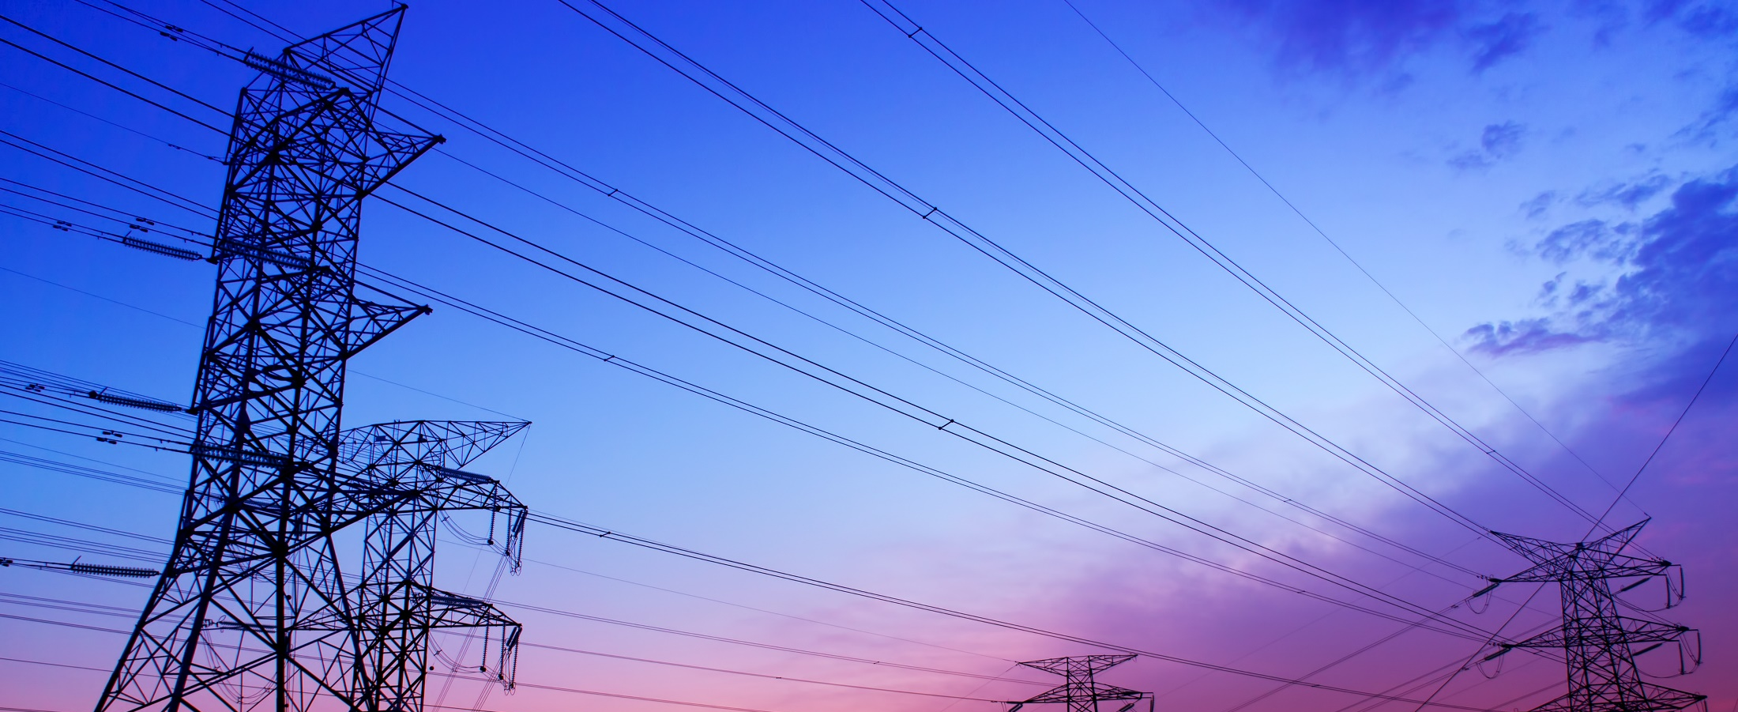
Enel Networks and Infrastructures
One of the largest Distribution System Operator in the world
31 million customers (>85% electric customers)
Over 1 million km of lines
(MV and LV)
Over 400.000 MV/LV Substations
About 2.000 HV/MV Substations
19.000 Employees
4 Macro -Regions
11 Control Centers
115 Territorial Units

Slide 3
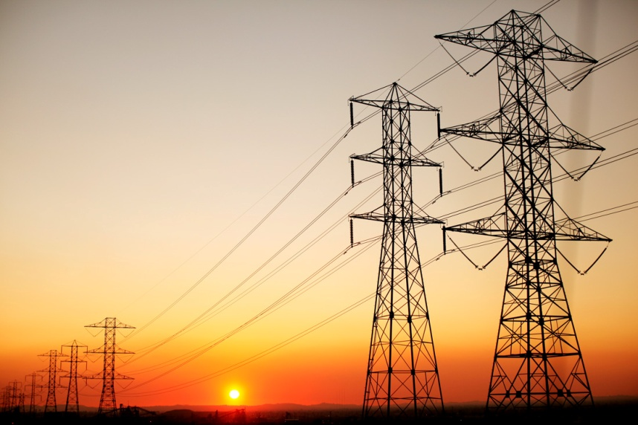
The Italian Regulation of Continuity of Service
The Objectives (as stated by Italian Regulator ⁽¹))
The Regulation of Continuity of Service started in the year 2000, with the following objectives:
To improve the Italian average level of continuity towards European benchmarks (FR, UK, DE)
To reduce the gaps between the best and worst served customers (Northern and Southern regions)
To increase network investments for maintaining good levels (if achieved) or for improvement
(1) : from “REGULATION AND INCENTIVES FOR IMPROVING CONTINUITY AND QUALITY OF SUPPLY” - Luca Lo Schiavo, AEEG, CEER

Slide 4
The Italian Regulation of Continuity of Service
The “basic” principles for Regulatory Schemes
(as stated by Italian Regulator (1))
A Sound Quality Data Monitoring System is needed
Audits are Essential
Scheme has to be Fair and Simple to Implement
Quality Regulation is Never a Permanent Solution
Gradual Approach to the Implementation Process gives great benefits
An Open Dialogue across all interested parties is a
fundamental part of an efficient regulation
Be Results Oriented
Implementation is the Hard Work
The aim of the Regulation is improving

Slide 5
The Italian Regulation of Continuity of Service
Having a Good Quality Data Monitoring System
All interruptions have to be recorded
Automatic identification and logging of interruptions is required for all the remote controlled breakers for HV and MV Power Lines
Each year, the Regulator carries out Audits in the Operative Centers to verify the correctness of Continuity data and

Slide 6
The Italian Regulation of Continuity of Service
Having a Good Quality Data Monitoring System
“With Notice”
If the notice to the customers is given two workings day in advance
“Without Notice”
Long (duration >3 min)
Short (duration >1 sec and <=3 min)
Transiet (duration <=1sec)
Type
Causes
“Force Majeure”
“External”
“Other Causes”
Origin
Transmission Network
High Voltage Network
Medium Voltage Network
Low Voltage Network
Geographical classification: High, Medium, Low Inhabitants Density Districts

Slide 7
The Italian Regulation of Continuity of Service
The main Continuity Indexes
SAIDI_{XV} : System Average LONG Interruption Duration Index
Σ XV Customer Interruption Durations
SAIDI_{XV} =
Total Number of XV Customers Served
SAIFI_{XV} : System Average LONG Interruption Frequency Index
Σ Total Number of XV Customers Interrupted
SAIFI_{XV} =
Total Number of XV Customers Served
MAIFI_{XV} : Momentary Average Interruption Frequency Index
Σ Total Number of XV Customers Short Interruptions
MAIFI_{XV} =
Total Number of XV Customers Served

Slide 8
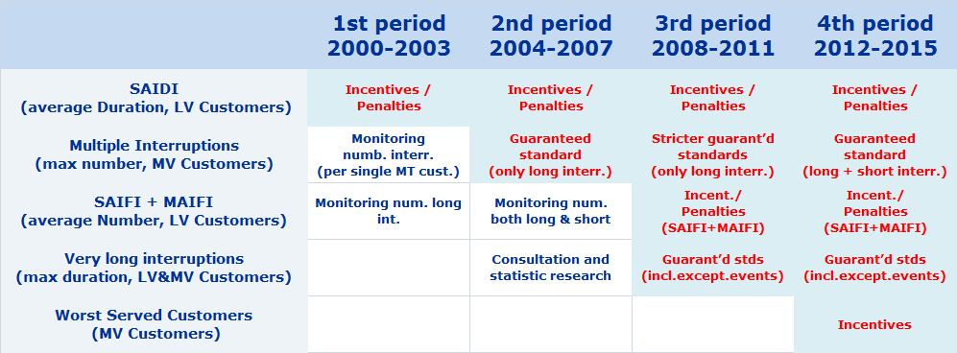
The Italian Regulation of Continuity of Service
The promotion of Quality Improvement
2000-2012 : The Quality Improvement Roadmap

Slide 9
The Italian Regulation of Continuity of Service
The promotion of Quality Improvement
2000-2003 : 1st Regulatory Cycle
Objective: Reduction of SAIDI (Minutes Lost per LV Customers)
Number of the LV Customers affected by the single interruption lasting Di minutes
Number of the total LV customers served in a specifc territorial Unit
The italian territory is divided in 350 territorial units TU (rural, semiurban, urban area of each Italian Province)
For each TU the regulator sets a starting level of SAIDI indicator and a trend of required improvement for each year.

Slide 10
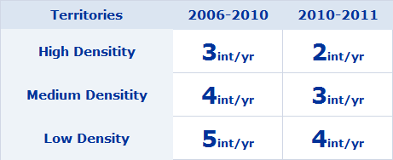
The Italian Regulation of Continuity of Service
The promotion of Quality Improvement
2004-2007 : 2nd Regulatory Cycle
Objective: Reduction of LONG (>3 min.) Interruptions affecting MV Customers
Regulation: Guaranteed Yearly Standards for Max Number of Long Interruptions to the MV Customers
Standards:
The DSO reimburses the each MV customer in case of underperformance

Slide 11
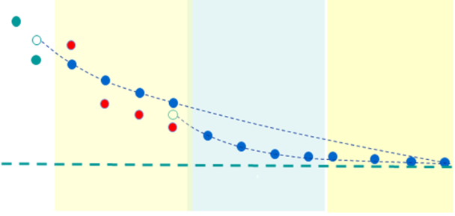
The Italian Regulation of Continuity of Service
The promotion of Quality Improvement
2008-2011 : 3rd Regulatory Cycle
Objective: Reduction of Interruptions affecting LV Customers
Improvement Scheme: yearly Incentives or Penalties based on actual results
Regulation: Reduction of SAIFI_{LV} + MAIFI_{LV} (>1 second)
The focus is on the Network Reliability
12 years regulation, Same scheme as Duration

Slide 12
The Italian Regulation of Continuity of Service
The promotion of Quality Improvement
2008-2011 : 3rd Regulatory Cycle
Objective: Reduction of Very Long Interruptions
Improvement Scheme: Automatic compensations to the affected customers
Regulation: Standard for Maximum Duration

Slide 13
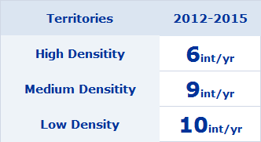
The Italian Regulation of Continuity of Service
The promotion of Quality Improvement
2012-2015 : 4th Regulatory Cycle
Objective: Reduction of LONG + SHORT Interruptions affecting MV Customers
Regulation: Garanteed Yearly Standards for Max Num. of LONG + SHORT Interruptions to the MV Customers
Standards:
Improvement Scheme: Only Penalities
Improvement Scheme: Automatic compensations to the affected customers

Slide 14
The Italian Regulation of Continuity of Service
The promotion of Quality Improvement
2012-2015 : 4th Regulatory Cycle
Objective: Reduction of Worst Served MV Customer
Regulation: Yearly reduction of the NEQ index
NEQ =
3 * Number of MV Cust above three times the standard +
2 * Number of MV Cust above two times the standard +
1 * Number of MV Cust above the standard
Improvement Scheme: Only Incentives proportional to NEQ reduction

Slide 15
The Italian Regulation of Continuity of Service
Let’s go straight to the results…
Data source: Italian Energy Regulator
3.5€/Year/ LV Customer
-74%

Slide 16
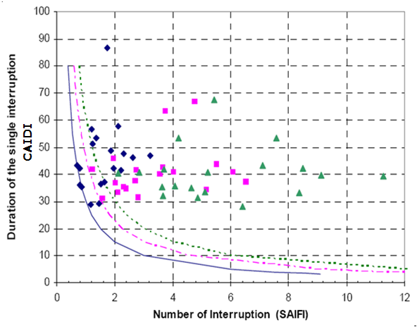
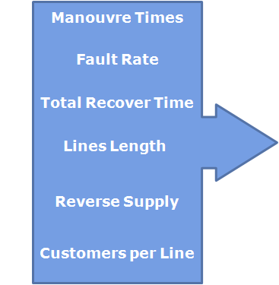
The Italian Regulation of Continuity of Service
An integrated approach of technical and organizational actions

Slide 17
Enel Distribuzione’s actions for the Regulation
The intervention levers to reduce the Duration of Interruptions
Manoeuvre Times
Fault Rate
Total Recover Time
Duration
Lines Length
Reverse Supply
Customers per Line
Possibility
to supply with contemporary faults

Slide 18
Enel Distribuzione’s actions for the Regulation
The intervention levers to reduce the Number of Interruptions
Manoeuvre Times
Fault Rate
Total Recover Time
Number
Lines Length
Reverse Supply
Customers per Line
Possibility
to supply with contemporary faults

Slide 19
Enel Distribuzione’s actions for the Regulation
The intervention levers to reduce the Very long Interruptions
Manoeuvre Times
Fault Rate
Total Recover Time
Very Long Interruptions
Lines Length
Reverse Supply
Customers per Line
Possibility
to supply with contemporary faults

Slide 20
Enel Distribuzione’s actions for the Regulation
Correttive Actions for the Reduction of Duration
Network Scheme Optimization
Maintenance
Remote Control
Neutral Ground Connection
Plants renewal
Structural Investments
Insulation improvement
Network Scheme Optimization
Neutral Ground Connection
Plants refurbishment
Number of Interruptions
Remote control
Structural Investments
Organizational improvement of operative Units’ interventions
Maintenance
Investment to contain the fault risk
Single Interruption Average Duration

Slide 21
Enel Distribuzione’s actions for the Regulation
Correttive Actions for the Reduction of Number of Interruptions
New HV/MV substations
Power Hubs
Network Scheme Optimization
Neutral Ground Connection
FNC Automation
Circuit Breakers Equipment into MV/LV substations
Overhead Insulated Lines
Insulation improvement
Network Scheme Optimization
Neutral Ground Connection
Overhead Insulated Lines
Plants refurbishment
Number of Interruptions
New HV/MV substation
Power Hubs
Circuit Breakers Equipment into MV/LV substations
Structural Investments
Remote Control
Maintenance
Investment to contain the fault risk
Number of customers per MV power line

Slide 22
Infrastructure and Networks Division
Remote control and automation system
The Process
The process to be controlled begins from HV/MV substations (primary substations), goes ahead in MV/LV substations (secondary substations) and terminates in correspondence of LV energy meters in customer premises.
ENEL D network has the following standard of voltage levels :
Stazione AAT/ AT
Stazione AAT/ AT
HV
Cabina
Primaria
linea AT
AT
utente AT
MT
linea MT
HV: 132–150kV: 2,000 HV/MV substations
MV: 10kV, 15kV, 20kV: 334,000 km lines
410,000 secondary substations
LV: 230/400V: 740,000 km lines
MT
linea MT
MT
MV
Cabina
Secondaria
utente MT
Cabina
Secondaria
BT
linea BT
utente BT
LV
utente BT

Slide 23
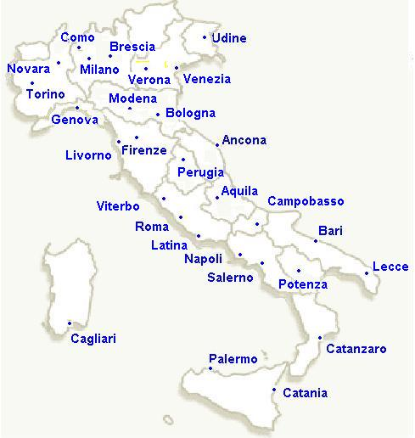
Infrastructure and Networks Division
Remote Control and automation system
Controlled Network Primary subs: 2000 Remote controlled: all Secondary subs: 410.000 Remote controlled: 100.000 (25%) Distribution control Centers (CO): 28
HV-MV: 18 MV: 10 Average Values
Primary subs per CO: 80 Secondary subs per CO: 14000 Remote controlled per CO: 3400

Slide 24
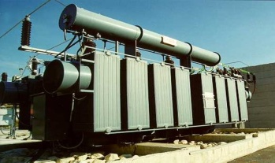
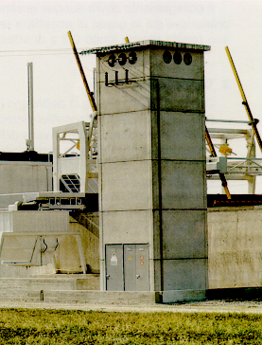
Infrastructure and Networks Division
Remote Control and automation system
The System
The System standardized by ENEL, is divided into 3 main Macro-blocks:
Central systems (STU-X/STM);
Telecommunication systems (several types);
Remote Terminal Units (TPT2000+ UP)
linea AT
National Grid
AT
MT
Primary Subs
STUx / STM
Secondary Subs
Corporate systems
MT
AUI
SOLC
GESI
GEINTE
GAM_TMT
BT

Slide 25
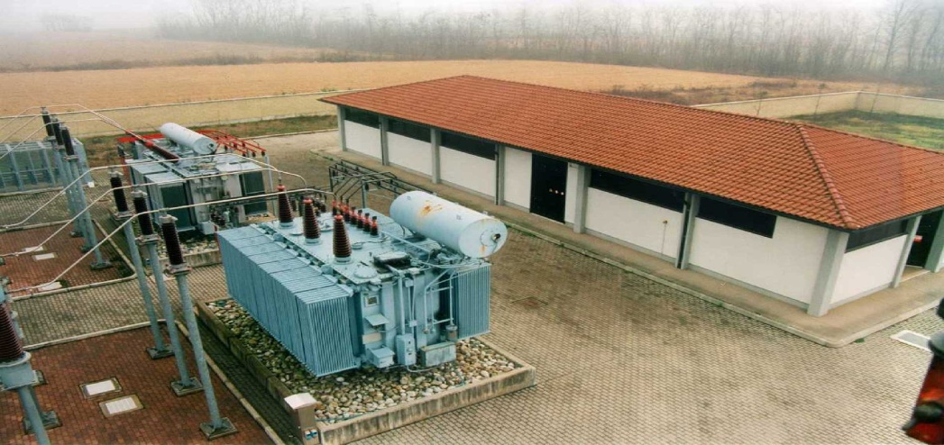
Infrastructure and Networks Division
Remote Control and automation system
Remote Terminal Units (RTUs)
Primary substations
Old “TPT TIC1000” (Analog point to point channels)
New “TPT2000” (Digital channels, IP networks)
The massive substitution of the old RTUs with the new one is in progress; the activity will last 9 years up to the 2013, covering all Primary substations in the territory

Slide 26
Infrastructure and Networks Division
Remote Control and automation system
Mv Network Automation – Summary
In the remote controlled secondary substations the remote terminal unit (UP) is able to open and close the switches according to a specific set of rules .
If you enable these rules, in case of a fault on the feeder, the switches are opened and closed according to these rules so as to isolate the faulty feeder section.
With the help of the recloser installed at the MV line departure in the feeding Primary substation, the healthy feeder sections located upstream the faulty ones are resupplied.
At the end of these sequence of operations the UP sends a spontaneous call to the control centre to alarm the operator on the events and to let him resupply the faulty sections located downstream the faulty one.
It is important to highlight that this function is performed by the UPs on the feeder and by the recloser in the HV/MV substation without any intervention of control center; therefore it works also in case of faults in Central system or in telecommunication systems.

Slide 27
Distribution Network Operation First Evolution of Distribution network – Improving of continuity of supply - NUMBER

Slide 28
The Spain Regulation of Continuity of Service
The Objectives⁽²⁾
The quality of service is the set of characteristics, techical and commercial power inherent enforceable by the subjects, and consumer by the component bodies of the administration.
Definitions of long interruptions: T>3 min
Indices used to quantify long interruptions:
TIEPI (is the equivalent interrupt time of the installed power in medium voltage (1 KV < V <= 36 kV)).
NIEPI (is the number of equivalent power outages installed in medium voltage).
80% of TIEPI and 80% of NIEPI at zonal level or individual level.
Reward or Penalty:
Spain applies a scheme that uses rewards for TSOs and incentives for DSOs. The continuity indicators are TIEPI and NIEPI. Different areas are considered separately. Smaller DSOs with less than 100,000 customers are excluded from the scheme. The incentive scheme does not use a dead band and does not require minimum improvements. The incentives (rewards, penalties, others) are not proportional to the difference between the actual performance level and the standard (or target). The amount of the incentives is funded by customers who pay for it through access tariffs.
(2) : from http://www.ceer.eu/portal/page/portal/EER_HOME/EER_PUBLICATIONS/CEER_PAPERS/Electricity/Tab/CEER_Benchmarking_Report.pdf

Slide 29
The Germany Regulation of Continuity of Service
The Objectives⁽³⁾
The aim of the quality regulation system is to achieve a socio-economically acceptable level of Continuity Supply by considering the costs of customers due to interruptions and a cost-benefit analysis of the DSO
Definitions of long interruptions: T>3 min
Indices used to quantify long interruptions:
From 2012 onwards, the performance is measured with SAIDI on LV and with ASIDI (Average System Interruption Duration Index ) on MV.
Reward or Penalty:
DSOs can receive a reward or a penalty on their revenue cap depending on their overall performance concerning to Continuity Supply in comparison to other DSOs.
(3) : from http://www.ceer.eu/portal/page/portal/EER_HOME/EER_PUBLICATIONS/CEER_PAPERS/Electricity/Tab/CEER_Benchmarking_Report.pdf

Slide 30
The France Regulation of Continuity of Service
The Objectives ⁽⁴⁾
Definitions of long interruptions: T>3 min
Indices used to quantify long interruptions:
Distribution: SAIFI, SAIDI and “Percentage of customers with insufficient quality of supply” (the definition of a “customer with insufficient quality of supply” depends on the location) There are several versions of each of these indicators, depending on the type of disconnection (planned/unplanned), the voltage level, the cause (exceptional event included or not), …
Reward or Penalty:
Uses a combination of rewards and penalties for distribution network continuity regulation.
SAIDI is addressed at distribution level. The expected level of continuity is estimated in line with the investment programme of the distribution companies and past values of indicators considered in the incentive scheme.
(4) : from http://www.ceer.eu/portal/page/portal/EER_HOME/EER_PUBLICATIONS/CEER_PAPERS/Electricity/Tab/CEER_Benchmarking_Report.pdf

Slide 31
THANKS

